Slide 1
Digital Business Environments Week 4 Lecture 4 Level 4 of a 4-level analytical stack: SLEPT Analysis

Slide 2
Directed Reading
Chaffey 6th Edition Chapter 4
GOV.UK Distance and Online Selling for Businesses
https://www.gov.uk/online-and-distance-selling-for-businesses
iWeb (2016) Legal Requirements for an e-Commerce Website
https://www.iweb.co.uk/2016/09/ecommerce-website-legal-requirements/
(this predates GDPR)
Sampson (2009) Law for Computing Students
In particular: Ch 7 (Web Law – contracts and defamation)
Also: 6 (personal data), 8.2 (accessibility regulations) and 4 (Intellectual property) Download from: http://bookboon.com/uk/textbooks/it-programming/law-for-computing-students

Slide 3
Industry News!
What’s happened in Digital Business since the last lecture?

Slide 4
Lecture Outcomes
Identify the different elements of the macro-environment that impact on an organisation’s digital business and digital marketing strategy
Assess the role of social, legal, economic, political and technical factors in providing constraints and opportunities to a company
Develop a clear understanding of the legal context for online business in the UK

Slide 5
And if I was a manager….
What are the constraints such as legal issues which should be taken into account when developing my digital business?
How do social norms impact on my digital business plans?
How is technological innovation impacting on my market?

Slide 6
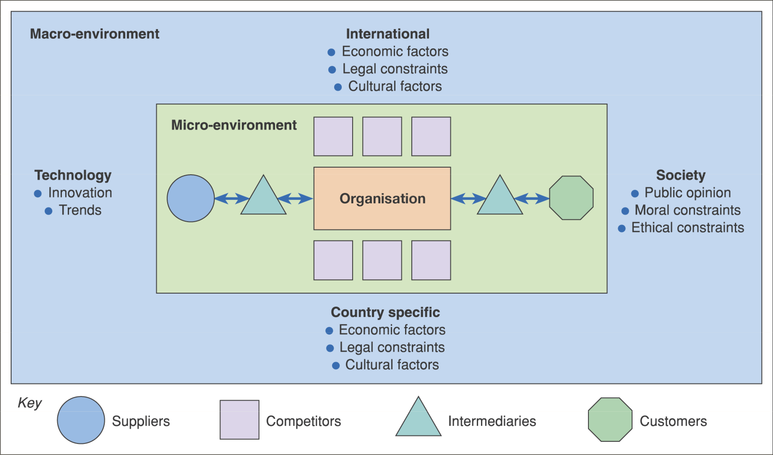
Figure 2.1 The environment in which digital business services are provided
Macro and Micro Environments – this week it’s Macro

Slide 7
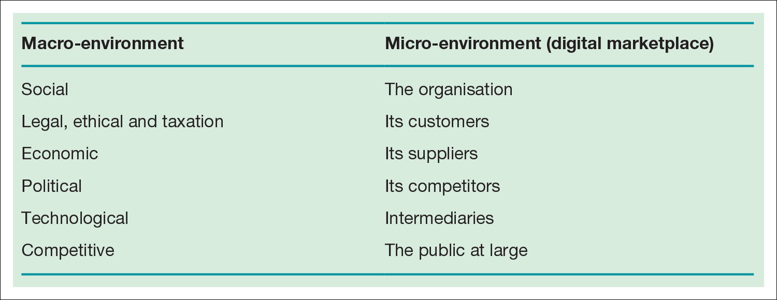
Remember the Distinction
SLEPT analysis
(or PEST or PESTLE)
SWOT analysis
Table 4.1 Factors in the macro-​and micro-​environment of an organisation

Slide 8
The Scope of Macro Environmental Scanning is large!
Social Factors – customer cultures, patterns of use and expectations of what others should and should not do online
Legal and ethical Factors – these determine methods by which online commerce should take place, try to ensure protection of individuals
Economic Factors – variations in economic performance affect spending patterns and trade
Political Factors – political moves to regulate online activity beyond commerce, but which may affect commerce
Technological Factors – changes in technology provide new opportunities for online business, which should be carefully assessed. Consider how fundamentally ‘mobile’ has changed online business
When conducting a SLEPT analysis don’t give equal weighting to each – focus on those that are most relevant (and in your coursework, too)

Slide 9
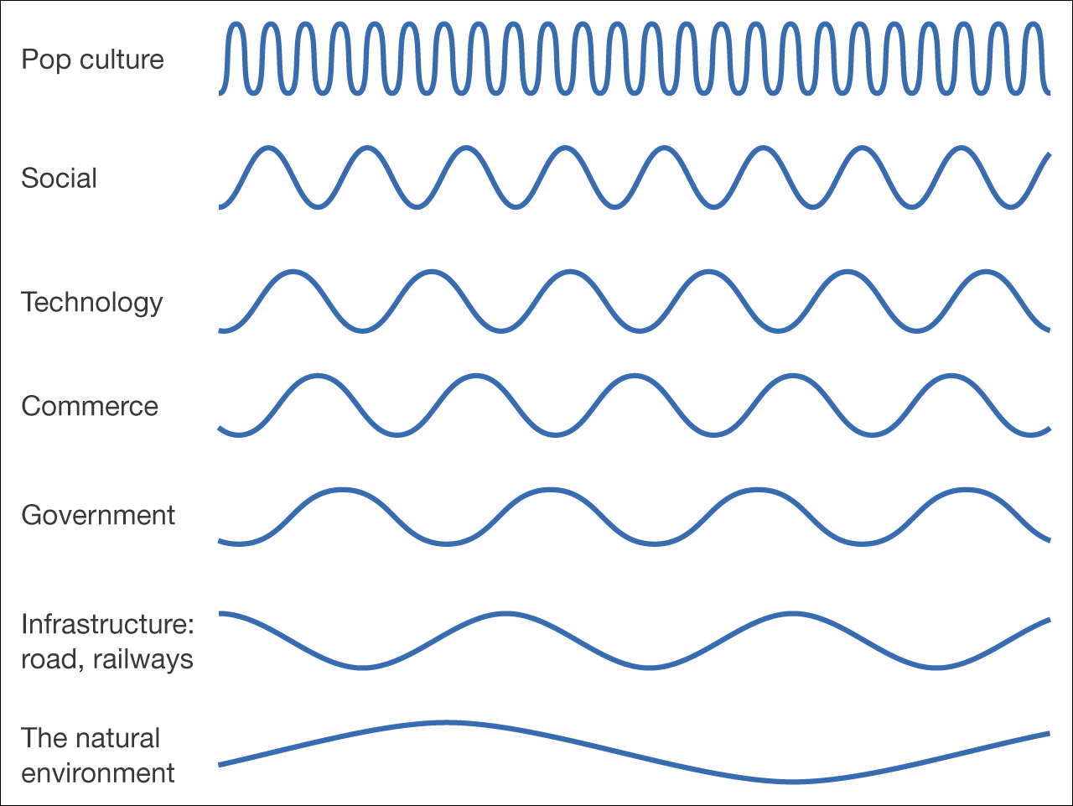
SLEPT factors aren’t static – there are ‘Waves of Change’
Figure 4.1 ‘Waves of change’ – different timescales for change in the environment

Slide 10
SOCIAL Factors affecting digital business
Scope of this category is potentially very wide, but the following issues have been pertinent
Unequal social resources and cost of access affecting uptake
Customer perception of the value of using a system/service (PU)
Ease of use (PEOU) – of a system/service (including accessibility)
Security and Privacy and the scope for surveillance
Fear of the unknown – much of the news about ‘digital’ in tabloid journalism focuses on pornography, crime and embezzlement, fraud and privacy infringements.
Issues 2 and 3 are modeled in the Technology Acceptance Model (TAM)

Slide 11
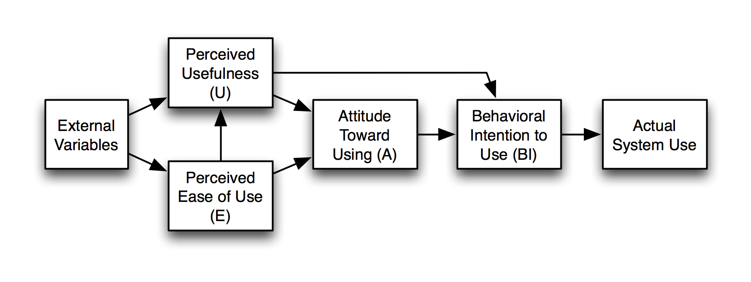
Technology Acceptance Model (TAM)
Davis, 1989

Slide 12
‘Social’ is about ‘Users’, and Users differ – by Demographics & Webographics
Webographics (Grossnickle and Raskin, 2001) covers:
Typical condition of use (on-the-go versus sedentary)
Device preferences
Speed of connection
Experience level
Usage type (purpose)
Usage level (advanced/basic)
- Webographics could be components of customer segments

Slide 13
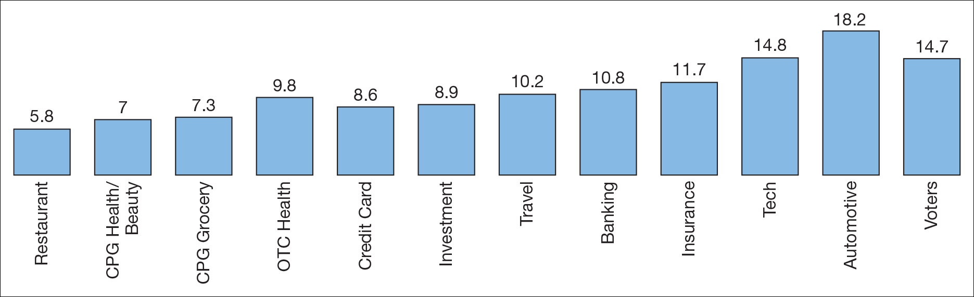
Users also show variety in e.g. the number of sources of info used to inform their buying decision
Google Shopper Sciences, 2011

Slide 14
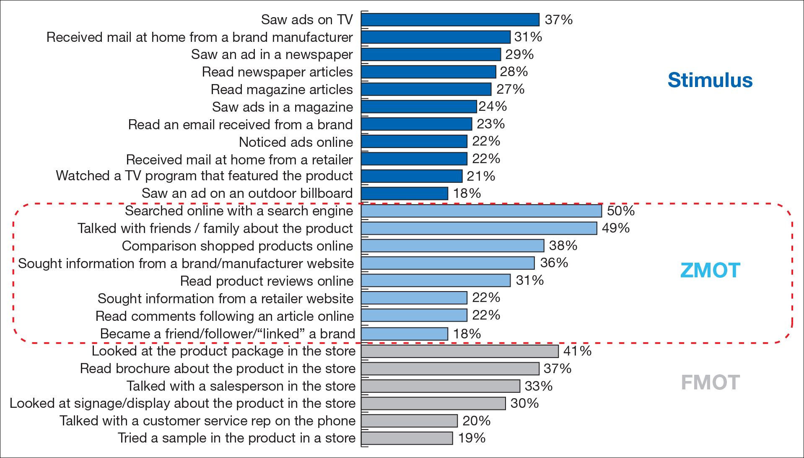
Google argued that ‘Search’ is important in purchase– the ZMOT

Slide 15
Psychographic Segmentation - very useful in analysing the relevance of social factors
De Corte & Van Kenhove (July 2017) One Sail Fits All? A Psychographic Segmentation of Digital Pirates https://link.springer.com/article/10.1007/s10551-015-2789-8
Four pirate segments were found based on differing combinations of attitude toward piracy, ethical evaluation of piracy and feelings of guilt.
The anti-pirate
The Conflicted pirate
The Cavalier pirate
The Die-hard pirate
These are be placed on a continuum of increasing pirating frequency, subjective norm, pirating self-efficacy, habit, and decreasing in perceived harm, respectively.

Slide 16
LEGAL is a hugely important SLEPT factor
We can place the focus of legislation for digital business into six main categories:
Data protection and privacy
Disability and discrimination
Brand and trademark protection
Contract law
Online advertising law
Intellectual property rights (relating to ‘information storage and transmission’)
Social media adds complications– brings problems around ‘representation of the offer’, ‘causing offence’, ‘astroturfing’, ‘defamation of customers and rivals’, ‘privacy of customer info’, ‘promotions and competitions’

Slide 17
Legislating for Digital Business
…isn’t easy, because of:
Considerable growth in terms of the number of users and the value and volume of trade
Evolving business models
Advances in the technologies being adopted to support business
And so the law is often left lagging behind
Some countries have attempted to create laws that accommodate the unique aspects of digital business, others have amended existing laws

Slide 18
Who makes the law?
UK ________
Scotland
Europe EU EEA
Treaties
WTO OECD
USA
SOX, USA FREEDOM
European Parliament and Council of Ministers approve
European Commission Implements
Directives &
Regulations
A business based in the UK is affected by more foreign laws and interests than one might think

Slide 19
Who makes the law?
Homework: If you have not heard of them before, find out more about these different bodies
(wikipedia is fine)
UK ________
Scotland
Europe EU EEA
Treaties
WTO OECD
USA
SOX, USA FREEDOM
European Parliament and Council of Ministers approve
European Commission Implements
Directives &
Regulations
A business based in the UK is affected by more foreign laws and interests than one might think

Slide 20
We’ll use the term ‘Liabilities’
If an organisation breaks the law per se, breaches their contractual obligation to a customer or somehow undermines their duty of care towards others, they are liable for prosecution in a court of law
Some liabilities will carry the threat of civil action whilst others will bring about criminal proceedings
We’ll cover some of the main issues that apply to the larger jurisdictions - specifically the USA and European Union (EU)

Slide 21
Liability 1. Privacy and Data Protection
Where we are, now:
The publication of privacy statements/policies on web pages has become common
It is advisable to prevent access to staff or customer personal data unless those individuals have given their consent
If personal information is being collected via a web page/app, the purpose for which the information is being collected should be stated
The recipients of the data should also be acknowledged and the individual should be able to choose if such recipients are to be given their data or not
Finally, the individual should be told how long the data is to be held
How did we get here, and where are we heading?

Slide 22
Privacy: The EU
The word ‘Privacy’ has various interpretations
In the EU it means an individual's (or a group's) right to determine what information about them is stored by, and passed to, whom
This concept of privacy underpinned the Data Protection Directive - stipulates that business should not mis-use personal data.
The new General Data Protection Regulation came into action in the EU on 25 May 2018
First, the DP Act

Slide 23
The UK Data Protection Act 1998
Based on European Union data protection directive 1995
If information was collected about employees, customers, contacts, etc. (eg name, address, etc.), business must
Say what will be done with the data (eg “stored securely on our own servers for one year and not passed to any 3rd parties”)
Register with the Government’s Information Commissioner
Not export the data outside the EU without permission from the people the data related to
Store the data securely, and show it and destroy it if the people the data refers to so wish
Misuse can lead to fines of up to £500,000
RSPCA fined in December 2016 for ‘wealth screening’
Superseded by the Data Protection Act 2018 (23rd May) which complements the GDPR (25th May)

Slide 24
The Data Protection Act 1998 Key concepts
Data subject
Personal data
Data controller
Authority of law
Who the data held relates to
The data held that can be related to a data subject
The person or organisation holding the data
One person in the organisation has responsibility
The state can specify legal exceptions (eg criminal investigations)

Slide 25
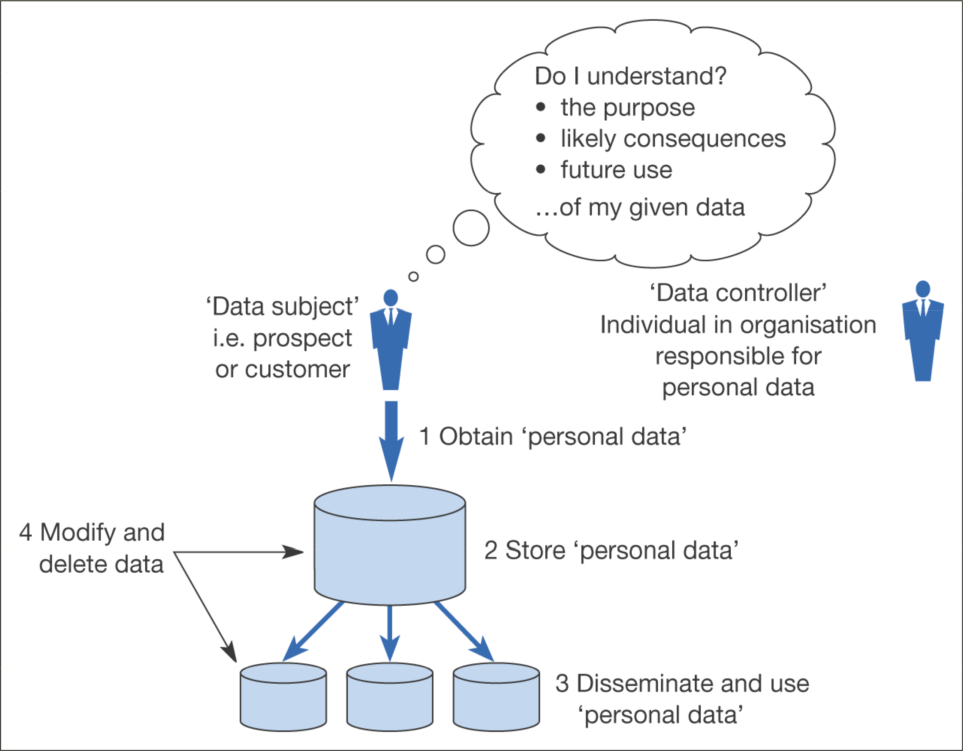
Figure 4.8 Information flows that need to be understood for compliance with data protection legislation

Slide 26
DPA Principle 8 Protection of outsourced (‘offshore’) data
There are no restrictions on the transfer of personal data to:
EEA states
EU Countries
Countries with “adequate protection”
Andorra
Argentina
Canada
Faroe Islands
Guernsey
Isle of Man
Israel
Jersey
Switzerland
Iceland
Norway

Slide 27
Export of Data to the USA has to be ‘managed’
Privacy Shield replaced the previous ‘Safe Harbor’ scheme that allowed the free flow of personal data from EEA data controllers to US organisations
Safe Harbor was ‘struck down’ after a ruling in October 2015 – didn’t offer strong enough protections to EU citizens’ data
Privacy Shield gives the EU better assurances that access to this data for national security purposes will be subject to clear limitations

Slide 28
Privacy in the USA is different from the EU, in Concept and Practice
In the USA privacy tends to mean the individual's right to be left alone, free from interference or surveillance
The USA has promoted (weak) business self-regulation instead of Europe’s approach
The result has been that a number of independent online bodies have appeared to help consumers judge the trustworthiness of traders
Traders can display the logos of such bodies on their sites and a click-through can confirm the traders stated good intent with respect to privacy
Unfortunately, the voluntary nature of these agreements has meant that there is often little legal recourse open to complainants

Slide 29
Regulation is sector-based in the USA
Instead of a blanket DP law, regulation is focused on key sectors
:
Government agencies
Healthcare
Financial services
Some US laws | Sector
HIPAA 1996 | Health sector
Electronic Comms Privacy Act 1986 | Government agencies (interception)
Federal Privacy Act 1974 | Government agencies (privacy protection)
Financial Services Modernization Act 1999 | Banks etc (privacy)
Sarbanes-Oxley 2002 | All big business
Patriot Act 2001 USA Freedom Act 2nd June 2015 | All data are subject to government requests Restored some elements of the Patriot Act with more safeguards
…and national security

Slide 30
Implications of Data Protection for UK Business
Security processes
Secure servers
Restrict movement of data out of office – eg USB sticks → VPN
Be careful with customers data
Data classification
Agreements / terms of use
Defined access levels
Archiving / deletion processes
Staff training – regular updates
Ethical behaviour
Help desk or other resource for staff to use
Develop incident handling processes
And businesses had to make further plans to abide by the GDPR….

Slide 31
General Data Protection Regulation (GDPR)
http://www.itpro.co.uk/it-legislation/27814/what-is-gdpr-everything-you-need-to-know
Introduced tougher fines for non-compliance and breaches
Gave people more say over what companies can do with their data
Made data protection rules more or less identical throughout the EU.
Drivers for the GDPR
To improve trust in the digital economy The current legislation was enacted before the internet and cloud technology created new ways of exploiting data, and the GDPR seeks to address that. Gives people more control over how their personal data is used by companies such as Facebook and Google. Stronger legislation with tougher enforcement.
To give businesses a simpler, clearer legal environment to operate in By making data protection law identical throughout the single market, it’s estimated businesses will save a collective €2.3 billion each year.

Slide 32
General Data Protection Regulation (GDPR)
http://www.itpro.co.uk/it-legislation/27814/what-is-gdpr-everything-you-need-to-know
In a Nutshell
https://www.youtube.com/watch?v=w8W2614bcHQ

Slide 33
Liability 2. Disability and Discrimination
Importance of web accessibility for all abilities is recognised in law
Anyone offering goods and services to the public is required to make them equally accessible to the disabled, as far as that is practical
Introduced the need to make ‘reasonable adjustments’
Effective from October 1999, when Part III of the Disability Discrimination Act 1995 came into effect
Extended by the Disability Discrimination Act 2005 and the Equality Act 2006
Cemented in the Equality Act 2010 (doesn’t specifically refer to ‘online’)
More in Sampson Ch 8.2

Slide 34
Reasonable Adjustments
Disability | Reasonable adjustment | Client / server end
Tunnel vision | Text resizing | Client
Deafness | Subtitles on visual content | Server
Blind | Voice command | Client
Blind | Tagging | Server
Dyslexia | Change colour contrast | Client
Learning disability | Easy English. Easy navigation. Abridged, basic pictures | Server
Physical issues | Well-tagged webpage
Epilepsy | Warnings on flashing content | Server

Slide 35
Accessibility
World Wide Web Consortium (W3C) is an international community where Member organisations, a full-time staff, and the public work together to develop Web standards. Founded and currently led by Tim Berners-Lee.
The mission of the W3C’s Web Accessibility Initiative (WAI) is to lead the Web to its full potential to be accessible, enabling people with disabilities to participate equally on the Web.
https://www.w3.org/standards/webdesign/accessibility

Slide 36
Liability 3. Brand and Trademark Protection
The use of trademarks and brandnames within Domain Names, content on Site and paid Search (eg Google Adwords) is all controlled by the Advertising Standards Authority (ASA, more later)
Companies also have to monitor how their own brands are represented on 3rd party sites, partners, publishers and social networks
Defamation of employees is an issue in the social media space – fair vs unfair criticism – online Defamation occurs at the point at which a comment is read, not where the server is located

Slide 37
Liability 4. Contracts - Levels of Service
Companies have a responsibility to maintain some level of service – typically this is defined in the contract. Think of Netflicks!
If the contract has no clauses to limit such liabilities and some service fails, for instance a stream is not available, then they are liable
However, the liability is unlikely to lead to a prosecution, unless it can be proven that a competent, comparable organisation could reasonably have been expected to have avoided the same failure
The failure itself is not sufficient for a successful action

Slide 38
Liability 5. Online Advertising Law
Most jurisdictions have some form of advertising regulations in place
These place restrictions on content, subject matter and form
For instance, the size of print, the national language, the warnings to be carried, etc.
Web-based material can potentially be viewed from almost anywhere in the world
It is conceivable that any advertisement will contravene some requirement of some law somewhere
In an effort to conform, sites with different suffixes can be aimed at each of the intended markets (e.g. .uk, .nl, .sg, etc.) or geolocation can be used
A local site can then be tailored to local laws

Slide 39
The Advertising Standards Authority (ASA)
The ASA is the UK Regulator
Has regulated the contents of adverts in paid-for space for many years
Banner ads, pop-ups and paid search results, all now included
The UK Code of Non-broadcast Advertising includes rules to make sure advertisements do not mislead, harm or offend
The ASA also scrutinises companies’ own marketing claims on their own websites (since 2011)
Applies to all UK based company websites regardless of the sector or size of business or organisation.
Includes other non-paid for space they control, like Facebook, Twitter and YouTube

Slide 40
Liability 6. Intellectual Property
To understand this issue properly we must also understand the issue of Information Storage and Transmission, and how the Internet has been viewed
The term ‘carrier immunity’ is important here
The ‘carrier immunity’ is also significant when we discuss online Obscenity and Indecency, and the reporting of legal cases online

Slide 41
Information Storage and Transmission: Carrier immunity
Traditionally, intermediaries (‘common carriers’) have not been held responsible for the content of transmissions they carry
Instead, the originator or sender of that material is liable
For example the postal service isn’t liable for the content of letters it carries
‘Carrier immunity’ is not usually extended to intermediaries who should be aware of the content they are carrying
eg newspapers.
Telecommunications companies have traditionally been granted immunity. They are unlikely to know of, or be able to know of, the content of all the transmissions they handle

Slide 42
Information Storage and Transmission: Carrier immunity
What about digital intermediaries?
Internet Service Providers
ISPs are increasingly held liable for what users do with their internet connection
Digital Economy Act (2010) stipulates that ISPs must monitor traffic to identify filesharers and then send them ‘cease & desist’ letters
Search Engines – e.g. Google
Legal battles around the world to maintain ‘carrier immunity’ status
Has had to yield in many cases
e.g. links to terrorism and child pornography websites
http://www.guardian.co.uk/technology/2011/jan/16/google-court-spain-privacy
Social Media Platforms – e.g. Facebook
Have largely conceded that they are to some degree responsible for content shared on their platforms

Slide 43
Information Storage and Transmission: Intellectual Property
An infringement of intellectual property occurs when an electronic copy of material (eg a digital file) is held without the permission of the holder of the copyright
Many online companies run the risk of legal prosecution from copyright owners if they inadvertently store and transmit material stolen by third party users of the service
YouTube actively monitors content against copyright infringements
Other companies (Megaupload, notoriously) insisted that they are NOT platforms, they simply connect users together and should be covered by carrier immunity

Slide 44
Information Storage and Transmission Obscenity and indecency
Obscenity and Indecency also come under this general heading of liability for information storage and transmission
the legal tests that may be applied to such material vary widely with locality
It is often the case that what is considered offensive to one party may constitute great art to others

Slide 45
Information Storage and Transmission Legal Process
Sub judice (under judgement)
when a legal case is imminent or underway, the courts, and/or the law per se, may restrict what can be published about the proceedings
This also restricts what can be posted online
If certain aspects are made public online, the publisher may be held in contempt by a court – including individual websites and the ISPs that host them
It’s difficult to stop information being viewed in one jurisdiction when it is hosted in another

Slide 46
Limiting Liability around ‘Storage and Transmission’ 1
Examples of good practice for companies are:
Actively monitoring and auditing the data of users
Providing some means of allowing the public to report infringements
Immediately removing, amending or disabling access to reported material as soon as they knew of its existence
Ensure that data is kept to prove that the company did not know of an actual infringement and could not have been expected to know of it

Slide 47
Limiting Liability around ‘Storage and Transmission’ 2
Ensure no financial benefit gained by the company
In a contract (terms of use statement), making reference to
the responsibilities and limitations of users
the right of the company to take certain action if infringement is suspected
the limits of the company's liabilities
Facebook’s terms of use are explicitly designed to limit Facebook’s liability for what users do on the platform.

Slide 48
Primary e-Commerce Regulations
These two regulations are the most important in conducting e-commerce:
The Consumer Contracts Regulations 2013 (replaced the Distance Selling Regulations 2000)
The Electronic Commerce Regulations 2002 – often known as 'E-commerce Regulations’
Additionally, businesses must also comply with the laws concerning physical transactions like the Supply of Goods and Services Act 1982, and the Consumer Protection Act 1987 to name a few.

Slide 49
Consumer Contracts Regulations 2013
Covers all forms of distance selling, not just online
Seller must provide certain information:
Their details, including a physical address and a phone number
A description of what you are buying, as well as how long you will be committing yourself to payment for any included service
The total cost, or an explanation of how this will be worked out if it can vary
How much delivery will cost, as well as how returns will be paid for and the price of these
Details of your cancellation rights, and a standardised cancellation form you can use (or details of where to find it)
Information on whether digital products will work on certain hardware or with other software
This has to be provided in a ‘durable medium’

Slide 50
Consumer Contracts Regulations 2013
Delivery rights:
When customers order goods, they should arrive within the time period promised by the seller.
If they do not specify a delivery date, the goods should arrive no more than 30 days after purchase – though this is in extreme situations, and the seller should not delay sending items unnecessarily.
Until the goods have been received, the seller remains responsible for their condition.
Cancellation rights for physical goods:
Customers can cancel goods at any time beginning from the moment they order them up until 14 days after receiving them – they then have further 14 days to return the goods.
Many goods must be kept shrink wrapped

Slide 51
Consumer Contracts Regulations 2013
Cancellation rights for services:
The right to a full refund lasts for 14 days from the moment of signing to buy a service.
However, this depends on the customer not using the service within this period, giving them an opportunity to decide whether or not they want to pay for it.
Customer can request immediate use, in which case the 14-day cancellation period does still apply, and the customer may be charged for the times they did make use of the service.
Some services, mostly those which involve carrying out an activity on a specific date (such as attending a concert or staying in a hotel), are not subject to these cancellation rules. Urgent repairs or maintenance requested from a trader are also exempt.

Slide 52
Consumer Contracts Regulations 2013
Cancellation rights for digital goods:
When customers purchase digital content, the seller should not provide it until the 14-day cancellation period has elapsed, unless you decide otherwise.
If customers wish to receive it immediately, then they will lose any cancellation rights.
The seller must make this clear to customers before allowing them to download it early.
Additional rights:
Sellers are now not allowed to charge for any additional goods or services which are tacked on to an order through pre-ticked boxes.
Rules on product helplines - any number customers calling to enquire about an order or a product purchased can only be charged at the basic call rate. Customers can claim back the excess charge if they are forced to call a premium rate number for these purposes as an existing customer.

Slide 53
The Electronic Commerce (EC Directive) Regulations 2002, aka Ecommerce Directive
Applies to B2C and B2B trade.
The name of the business should be visible on the site and in emails. Including:
the registration number of the company
the real World address (eg street, town, etc)
phone numbers and email addresses
a VAT number
professional or trade scheme memberships and registration numbers
In trading (as per consumer regs) provide clear information on price, tax and delivery
Clearly show Terms and Conditions, and acknowledge orders when they are received

Slide 54
That’s the end of the ‘Legals’!

Slide 55
POLITICAL – Localisation is necessary
Singh and Pereira (2005) outline an evaluation framework for the level of localisation:
Standardised websites (not localised). A single site serves all customer segments (domestic and international).
Semi-localised websites. A single site serves all customers; however, there will be contact information about foreign subsidiaries available for international customers. Many sites fall into this category.
Localised websites. Country-specific websites with language translation for international customers, wherever relevant.

Slide 56
POLITICAL – Localisation is necessary
Highly localised websites. Country-specific websites with language translation; they also include other localisation efforts in terms of time, date, postcode, currency formats, etc. Dell (www.dell.com) provides highly localised websites.
Culturally customised websites. Websites reflecting complete ‘immersion’ in the culture of target customer segments; as such, targeting a particular country may mean providing multiple websites for that country depending on the dominant cultures present.

Slide 57
TECHNOLOGICAL
Responding to the rate of change – as appropriate for our segments
Which new technologies should we adopt?
Monitoring for new technologies and techniques
Re-skilling and training
Evaluation – are our customers early adopters?
Where are our customers on the adoption curve?

Slide 58
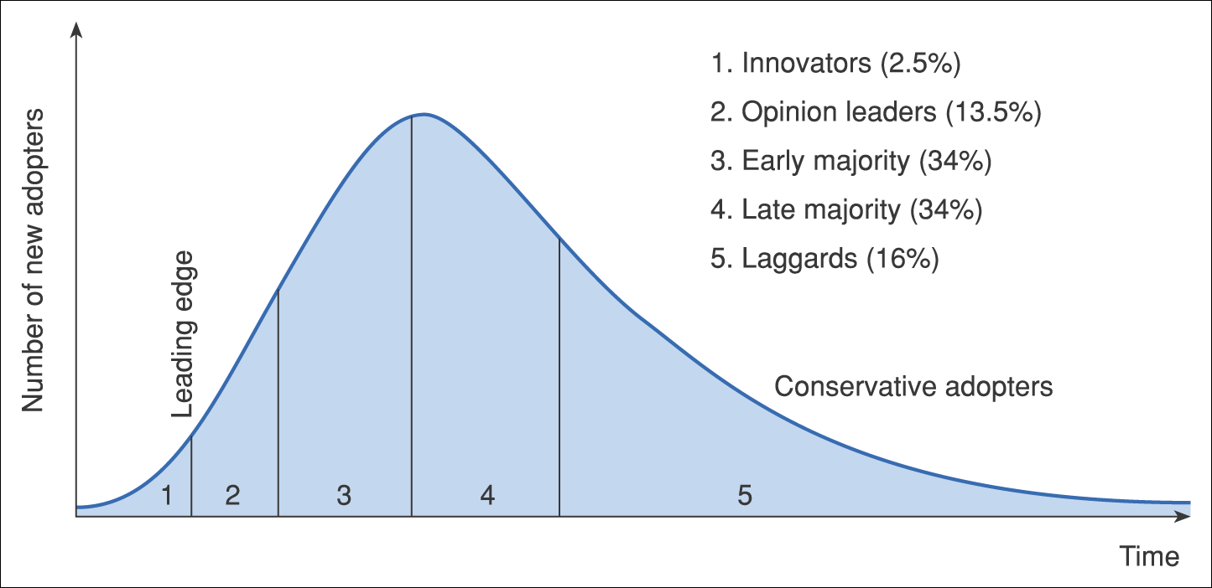
Figure 4.12 Diffusion–adoption curve of a Gartner hype cycle

Slide 59
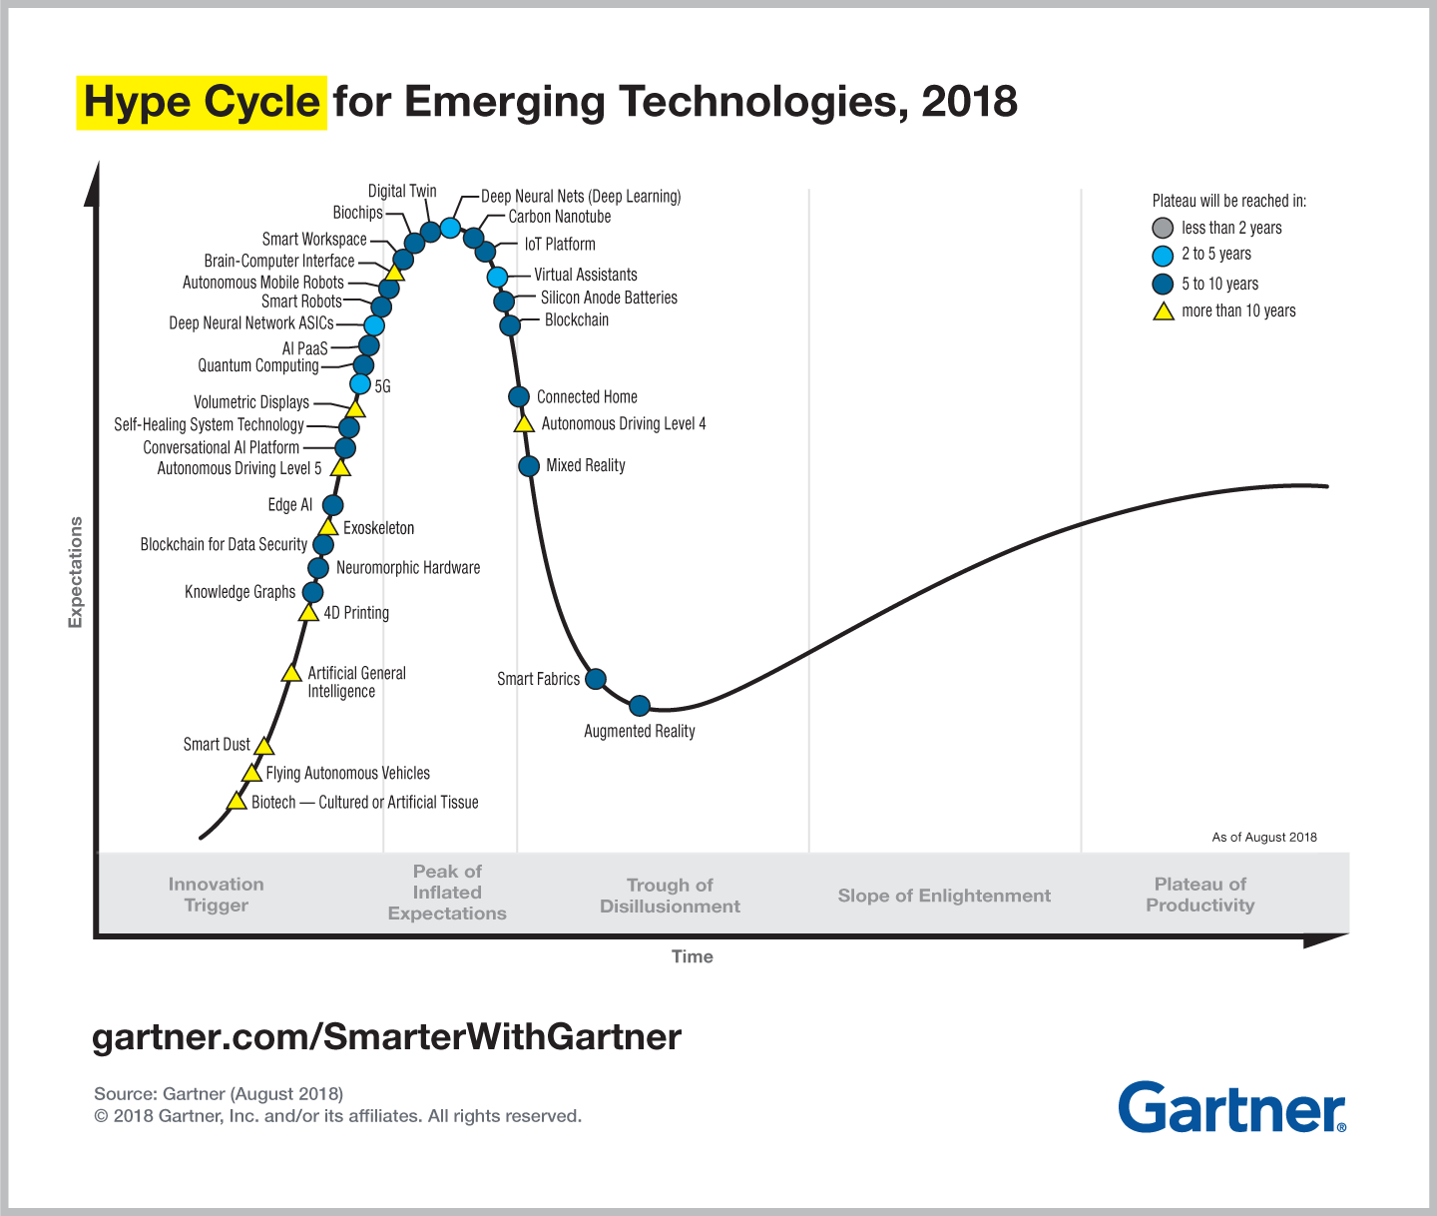
Notes:
Replace with 4.13

Slide 60
Week 5(23) (next week’s) Tutorial
You recently started a job as digital services manager for RBS
Produce a checklist of the relevant legal and regulatory issues that you need to check the website (and main supporting processes) are compliant with.
Look at some websites of RBS’ competitors, and assess different approaches to achieving and reassuring customers about their privacy and security. Cite three examples that you think RBS should also use.
You have been tasked with considering how RBS should monitor and respond to technological innovation.
Select two examples of technologies relevant to RBS that have generated hype, but have not delivered. Why did they fail to deliver?
Find out more about the Technology Acceptance Model (TAM) via a Google search. How might TAM be used as part of an effort to predict uptake of new technology by the customer base?

